Slide 1
Data Visualization
Jordan Waters

Slide 2
Better Betting with Time?

Slide 3
Using money lines to assume public sentiment
Casinos implement “money lines” to create even amounts of money wagered on both teams in a game.
A money line just means, bets placed on teams expected to win, payout less money, than bets placed on teams expected to lose.
The higher the money line for a team, the less likely betters think is it that that team will win.
I’m curious how well betters predict outcomes as the season progresses and more is learned about each team

Slide 4
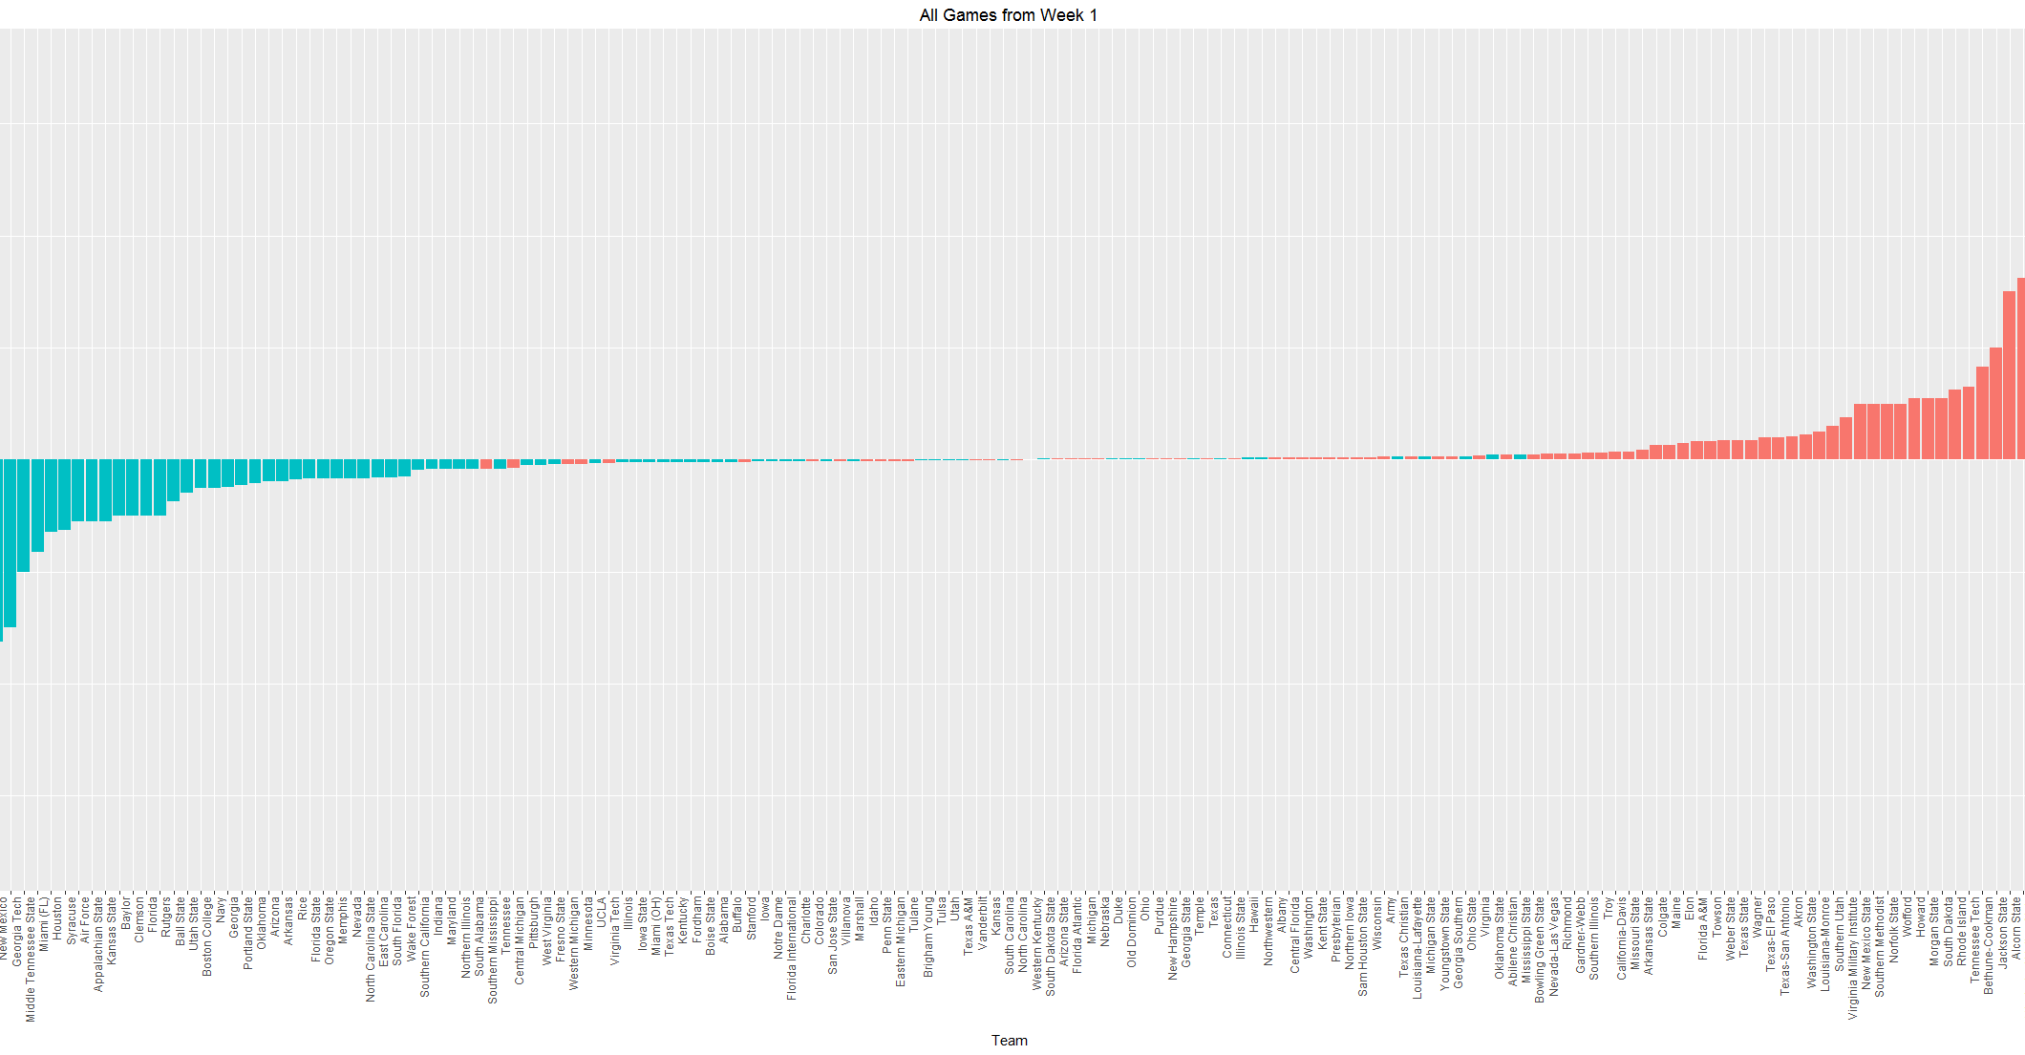

Slide 5
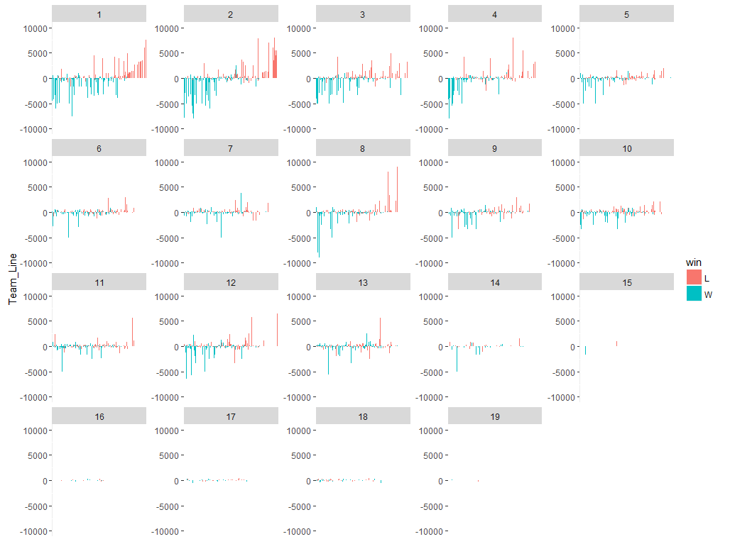
All money lines by Week

Slide 6
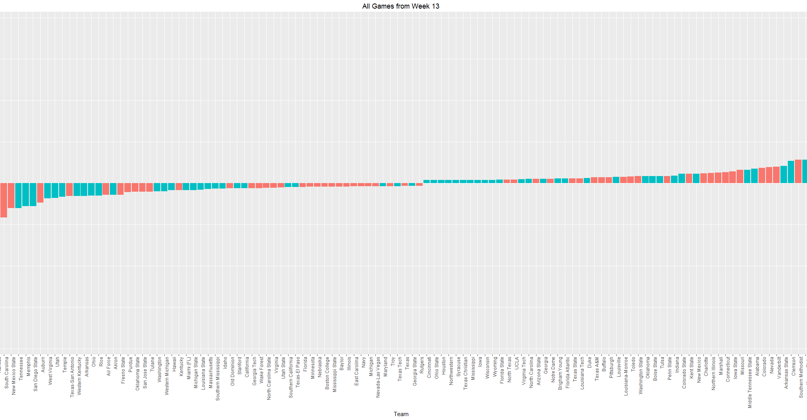

Slide 7
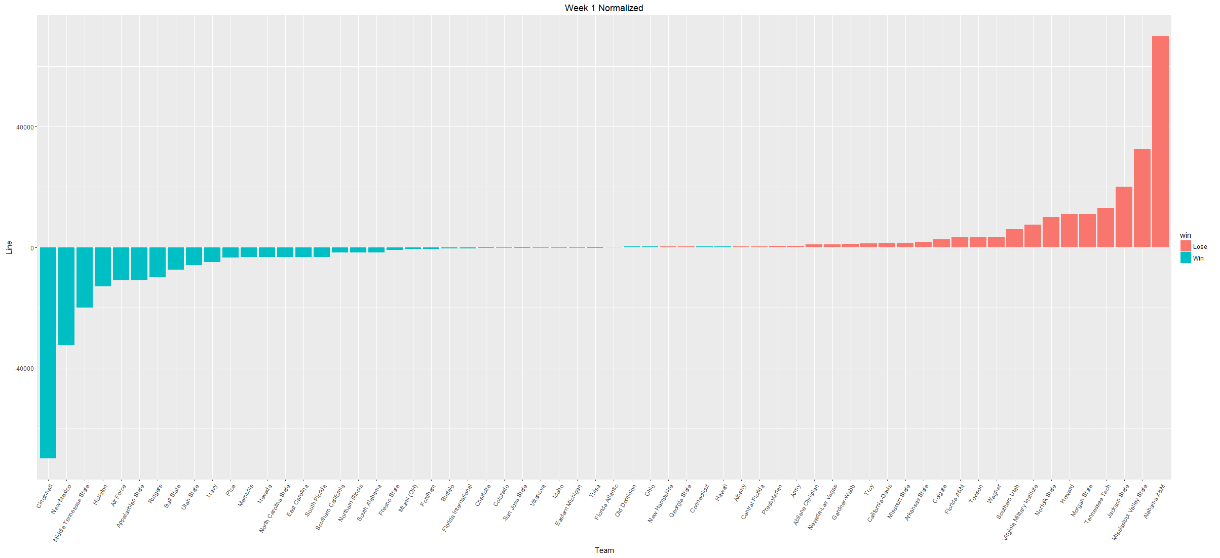

Slide 8
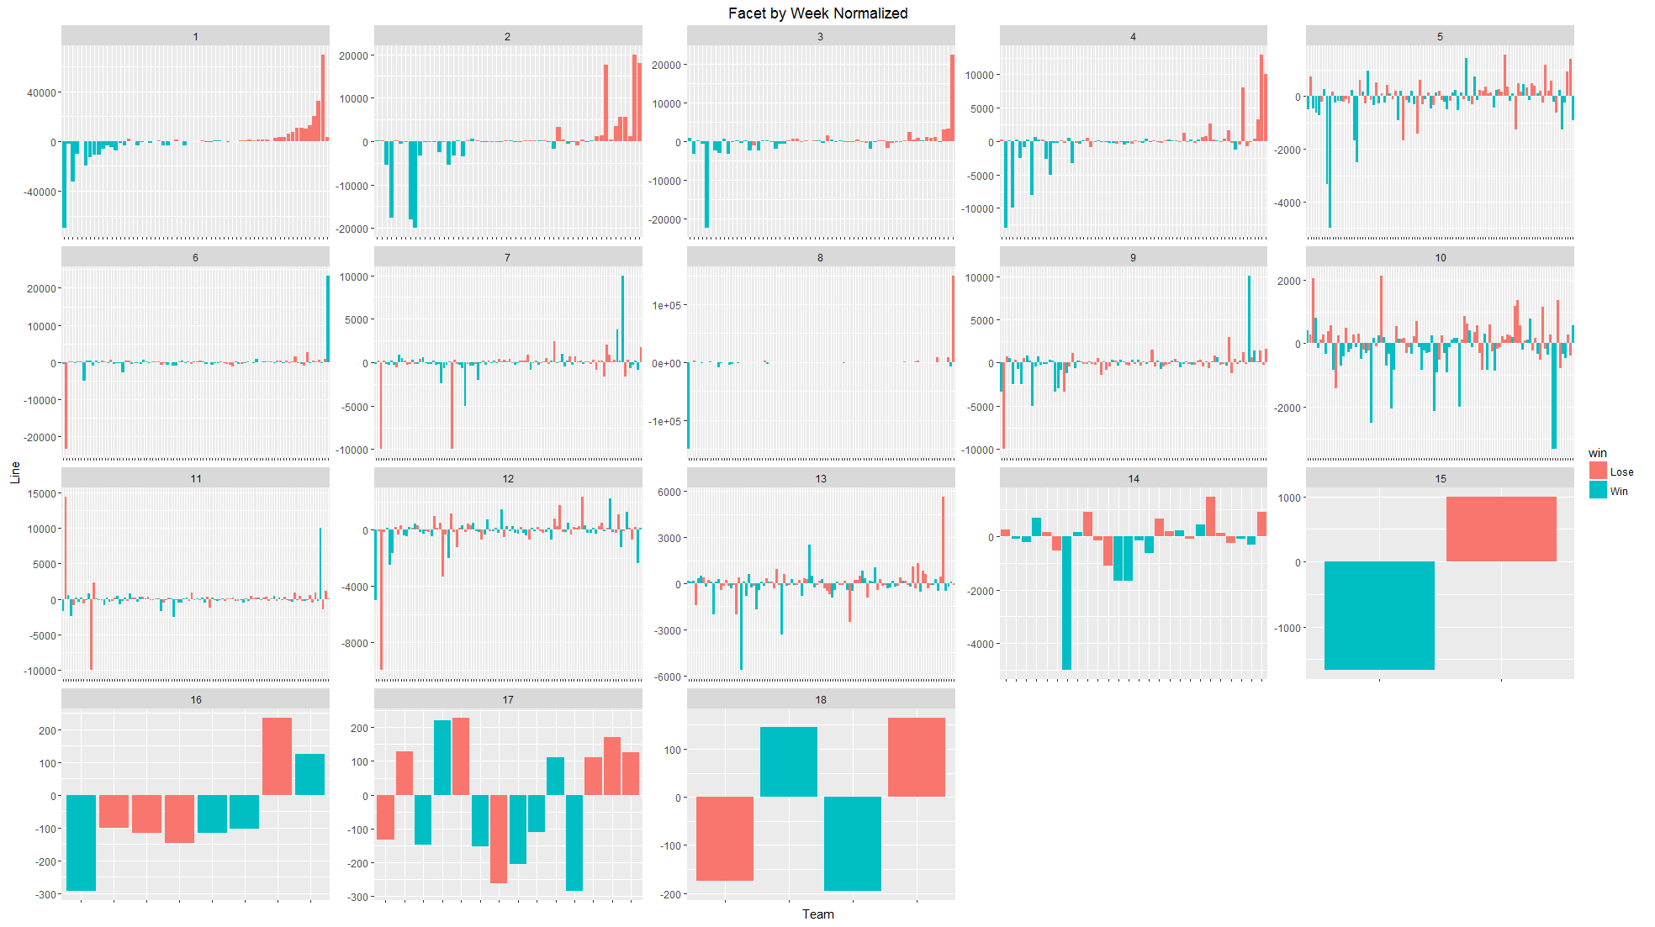

Slide 9
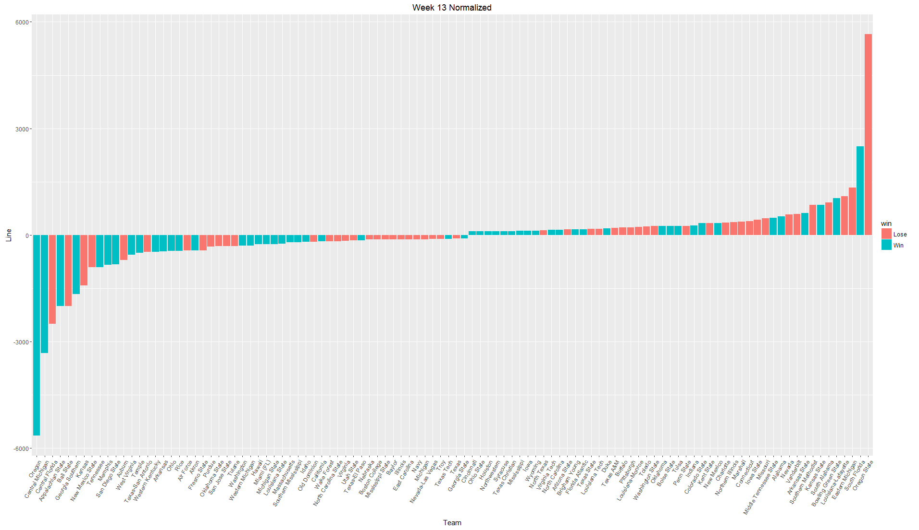

Slide 10
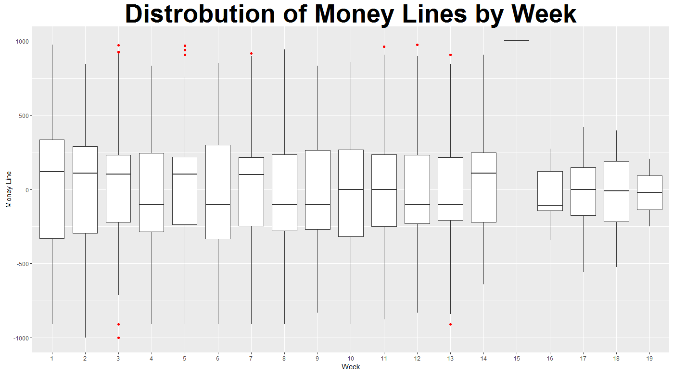
Does Confidence in games vary by week?
Answer:
Not dramatically

Slide 11
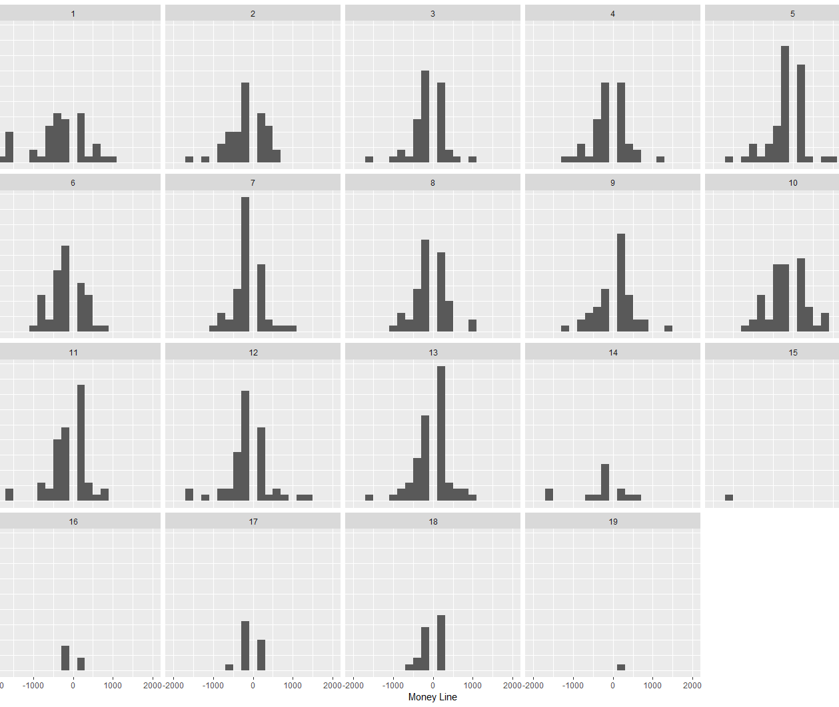
Distribution of Strength of bets on winner by week
Betters have less confidence as season progresses
Peaks slightly below zero indicate that public was generally good at picking close games.
Gap at zero is an artifact of how the money line works
Peak towards zero indicates betters need less incentive to bet both teams

Slide 12
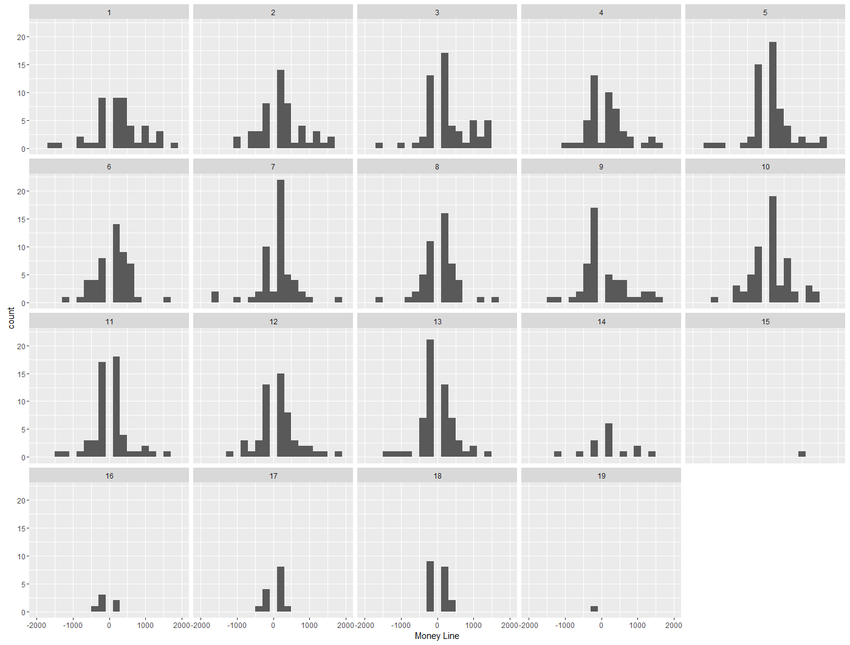
Distribution of Strength of bets on loser by week
If the public was always right, all of these moneylines would be above zero.
Again, most bets trending towards zero.
Public predictions seem to get worse as season progresses

Slide 13
If I had more time
Cleaning data took much more time than expected.
MORE DATA!
More seasons to see annual trends.
Finding non-game related data that may have an impact of games where betters were incorrect. (Abnormal weather, injuries, unusual game times)
Team trends.
Do betters favor certain regions of the country?
Are those trends unfounded?
Betting trends for home vs away?
Make visualizations prettier :(

